Slide 1


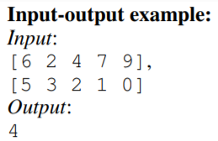
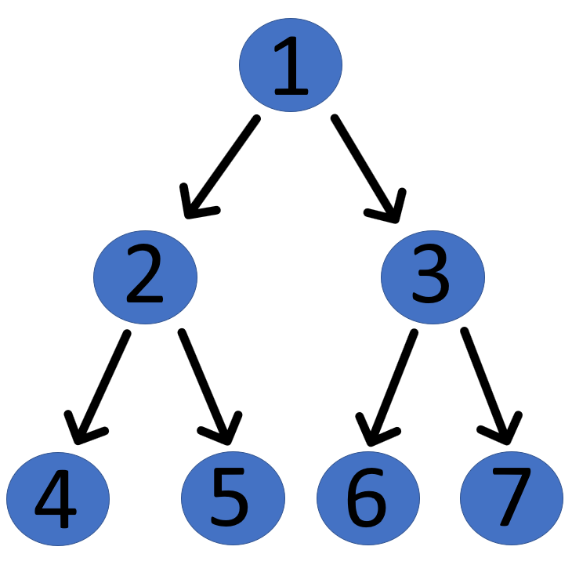
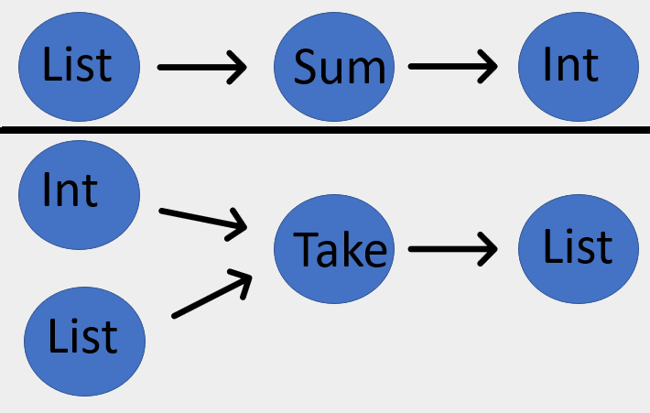
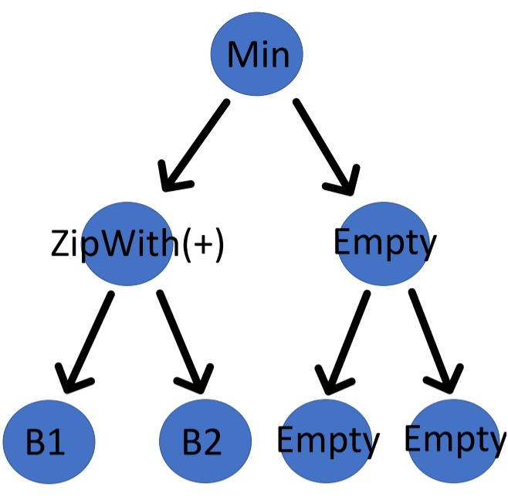




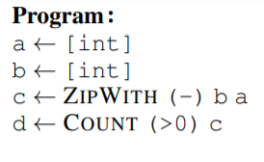
General-purpose Extensible Synthesis framework (GES)
Harutyun Rehanyan¹ and Ruben Martins²
¹Los Angeles Valley College
²Carnegie Mellon University
2020 Research Experiences for Undergraduates in Software Engineering Program (REUSE Program)
Goals
Motivation
Background
• Build program synthesizer capable of creating simple programs given input/out examples
• Modular DSL system to incorporate various functions, lambdas and HOFs
• Encoding synthesis problem into SMT and using pruning specifications if applicable
There exist three main types of program sythensizers; machine learning driven, inductive, and enumerative. GES belongs to the latter. The main motivation behind GES was to research how efficient of a system we could create and what kind of pruning specifications would provide the most benefit.
• Goal of Program Synthesis by Example is to create programs that satisfy all given examples
• SMT stands for Satisfiability Modulo Theories, which is a decision problem for logical formulas with respect to combinations of background theories
System Overview for GES
Read File Examples
Initialize DSL
Generate Structural Tree
Encoding to SMT
Encoding Pruning Specs
Test Enumerated Programs
Print Valid Program
DSL:
Initialize DSL: Output Functions: Sum, Take, etc Input Functions: B1, B2
Generate Tree
Results:
DSL stands for Domain Specific Language. In our program, we define 39 components. For instance, we have Take, Sort, Sum, Reverse, Head, Last, Drop, Access, Minimum, Maximum, Map, Filter, Count, ZipWith, ScanL1. In addition to these there are multiple lambda components that are used by Map, Filter, and Count.
B1:
B2:
K:
• GES: 3,600 lines of C++ code
• 10,000 programs enumerated and tested per minute
• Pruning reduces enumerated programs by up to 88.26%
• Pruning reduces search space by 75.04%
• Time to solve with pruning decreases from 61s to 26s
- No Pruning - “Max” Pruning - Both Specs - “Min” Pruning
Enumerate Program
Total Search Space
Encoding Well-Typed Programs: 1 =Output function
2, 3 = Any Function 4,5,6,7 = Input Function
Pruned Search Space With Min/Max
DSL
Functions
Test Program: B1 = [6 2 4 7 9] B2 = [5 3 2 1 0]
ZipWith(+) = [11 5 6 8 9] Min = 5 Incorrect output,
Tries new program from SearchSpace until correct
Higher Order Functions
Lambdas
Acknowledgements: I would like to thank Carnegie Mellon University and the REUSE program for making this internship possible. My most sincere gratitude towards my professor, Ruben Martins, program organizers Joshua Sunshine, Claire Le Goues, Charlie Garrod, and my fellow cohort members for their support and community, as well as the National Science Foundation for their funding
References:
[1] Leonardo Mendonça de Moura, Nikolaj Bjørner: Z3: An Efficient SMT Solver. TACAS 2008
[2] Yu Feng, Ruben Martins, Osbert Bastani, Isil Dillig: Program synthesis using conflict-driven learning. PLDI 2018
[3] Matej Balog, Alexander L. Gaunt, Marc Brockschmidt, Sebastian Nowozin, Daniel Tarlow: DeepCoder: Learning to Write Programs. ICLR (Poster) 2017
Contact Information
Harutyun Rehanyan
Los Angeles Valley College
Email: hrehanya@andrew.cmu.edu

